Slide 1
Using Linear Regression to Optimize MLB Player Selection
Predicting Win Percentage Based on Average Player Pay, Age, Experience, and Size

Slide 2
Design
My client is a general manager for an MLB team looking to optimize its roster based on static player metrics.
Baseball-Reference.com was the source of MLB team data from 1980 – 2020, which amounted to 1168 unique seasons.
Notes:
We want to focus on the right combination of characteristics that optimizes our win-loss percentage.
Selenium was used to scrape data

Slide 3
Discoveries
1. Overall team age and experience have more of a direct impact on winning than payroll budget.
2. Height & weight are overvalued qualities.
3. There is a 25% chance (with 20% mean average error) of increasing our win-loss ratio by selecting features that balance out the team’s overall age, years of experience, and salary.
Notes:
Want to start and end with discoveries so relevance isn’t lost in story.

Slide 4
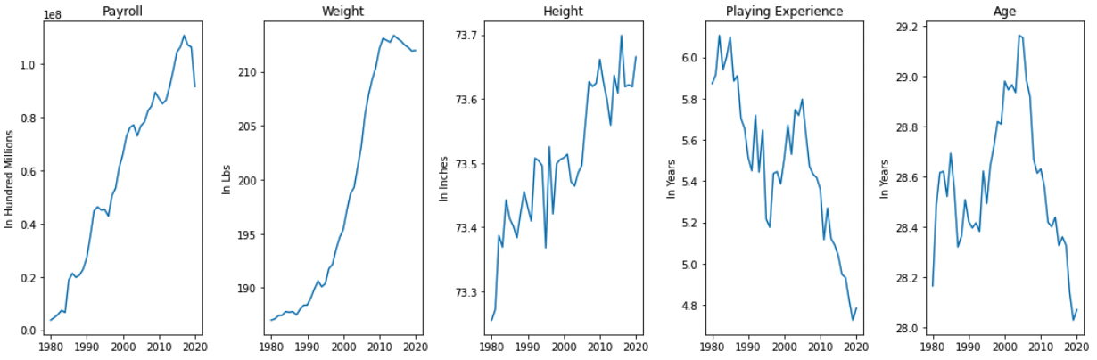
Aggregate Team Averages: 1980 - 2020
Team Average Payroll, Weight, Height, Experience, and Age by year
Notes:
Salary, weight, and height have had drastic upward trends over the last 40 years, even after adjusting for inflation.
Average experience is sloping downward.
Age was the only feature with no discernible trend (using seasonal decomposition):

Slide 5
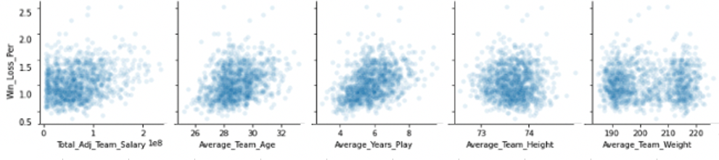
Dependent Groups Compared to Target
TARGET: Win – Loss Ratio (from .5 wins for every loss, to 2.5 wins for every loss)
Inflation-Adjusted Salary
Age
Experience
Height
Weight
Notes:
While there are only 5 variables (excluding year) in the screenshot, the dataset included 3 separate categories for pitching, batting, and the overall team.
This generated 15 variables per row.
For simplicity, only the overall team’s data is shown above.
A couple weak linear relationships can be seen from the visualization.

Slide 6
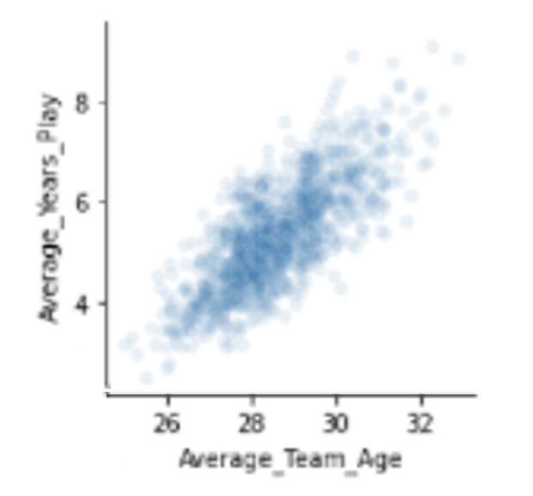
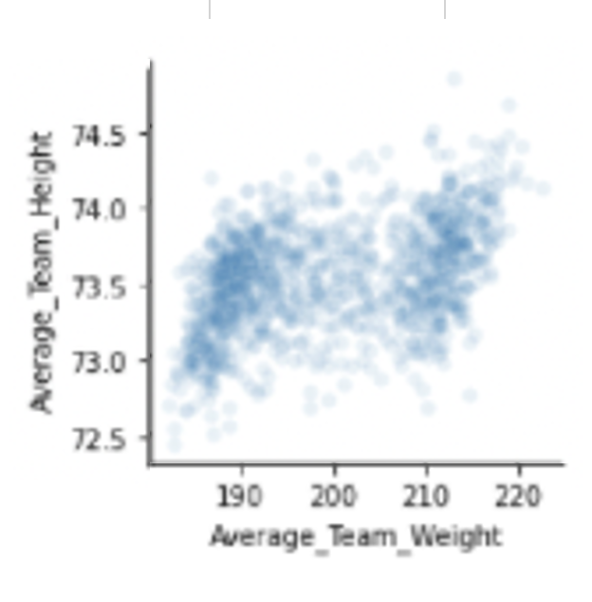
Linear Regression
Feature engineering was used to weigh & combine dependent variables with one another:
1. Weight + 3*Height
2. Age + 5*Years Experience
Notes:
Similar to a baseball team’s dynamic, it’s important to see how how all variables (“team mates”) interact with and impact one another.
Only judging their 1:1 relationships with the target might not give us the whole picture or the best predictor.
However, each variable isn’t completely independent of the others (height & weight, or age & years of experience).
This violates linear regression assumptions.

Slide 7


OLS Regression
The same percentage of data was explained by the data with and without the feature engineering: 20%.
The mean average error is the same amount, 20%.
Notes:
Feature engineering on this model did not impact the Ordinary Least Squares R-scores.

Slide 8
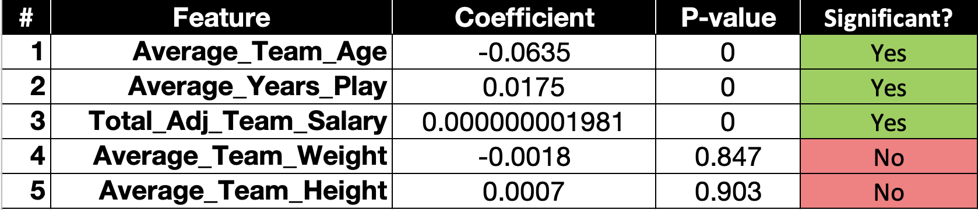
Coefficients ranked by Significance & Strength
Notes:
Here, the coefficient values of the simpler model are first sorted by their significance status, and then by their absolute value:

Slide 9
Prediction Results
The model did better on the unseen data (a 3% increase), suggesting it may be underfitting.
Could further increase accuracy by applying standard scaling.
Notes:
Disparate variable units in the coefficient values could hamper the model’s success (millions of dollars, dozens of years, hundreds of pounds, etc.).

Slide 10
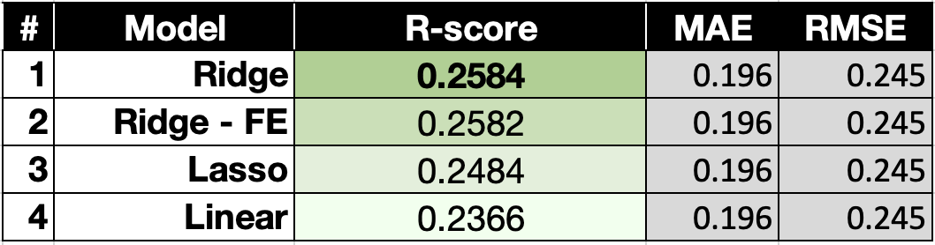
Standardized Data Modeling
Led to the strongest model, but in unexpected ways.
Notes:
Surprisingly, ridge & lasso also did NOT impact the coefficient values from the table on Slide 8.
They also had the same MAE & RMSE as the original regression models.
However, their scoring captured more of the data.
A 2.2% improvement may not seem large, but can make a substantial difference in the majors:

Slide 11
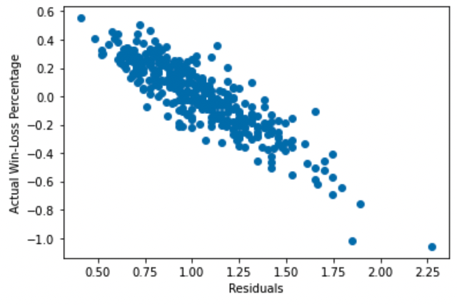
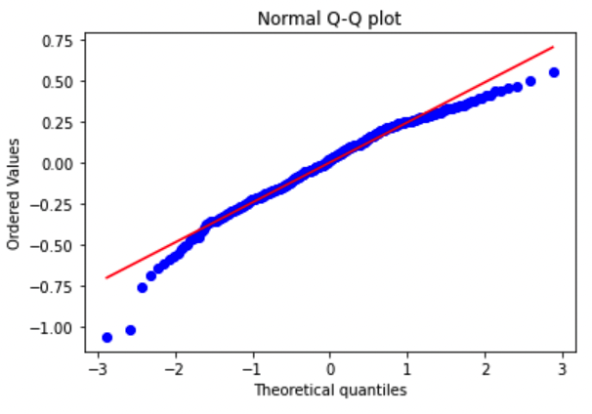
Residual Analysis
Scatterplot
Q-Q Plot
Notes:
Plotting the residuals reveals that the model is skewed left.
This indicates several possibilities: that there are other unaccounted features impacting the model, and/or that a more complex model may be more robust.

Slide 12
Key Take Away Points
1. Relative age and experience have a higher impact with winning than salary!
2. Height & weight have a high upward trend with time, but not winning.
These qualities may be overvalued in players.
3. A ridge-scaled model can help us predict the team’s seasonal win-loss % with 25% accuracy, and about 20% error.

Slide 13
END

Slide 14
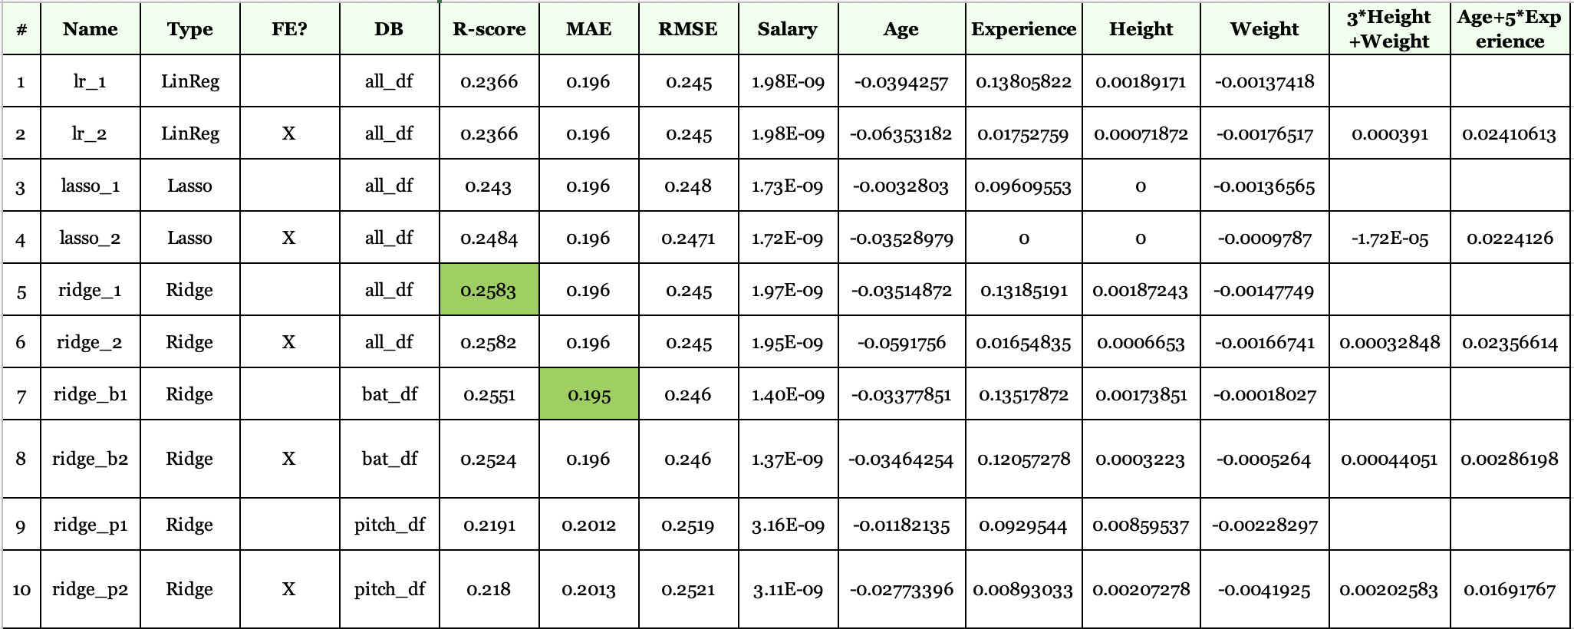
Bonus Slide: All Model Comparison

Slide 15
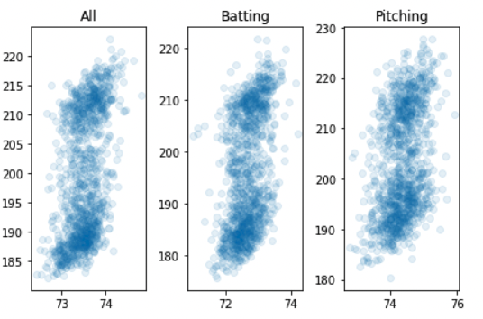
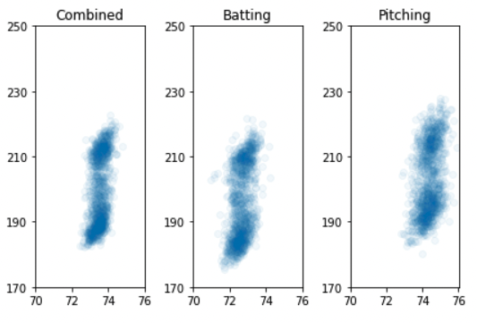
Bonus Slide Height-Weight Relationships & Groupings
These axes differ to highlight each group’s spread patterns.
These axes match to show difference between groups.
Notes:
There doesn’t seem to be much correlation between height/weight and our target.
However, there is a clear pattern of selecting 2 groups of body types:
1) taller, heavier players (sluggers, pitchers) or
2) shorter, lighter players (shortstop, pinch runner, outfielder).
Pitchers tend to be heavier and taller than batters, but the spread within each group is similar:

